Slide 1
Fatigue-Detector
A project by 3xpl0its.axx

Slide 2
PROBLEM STATEMENT
Drowsiness and tiredness during long online classes.

Slide 3
SOLUTION
The long duration of online classes has a bad effect on students both physically and mentally . So, we created a website that detects fatigue and drowsiness in the students along with other features.

Slide 4
DESCRIPTION
Our team presents Fatigue-detector, mainly developed keeping in mind the present trend of online classes.
Due to this pandemic all of us are spending a lot of time on our Computers and phones to attend our classes. Apart from this we also spend a lot of time watching tv shows, movies etc.In such a situation it is natural that students would get stressed and tired.Our project is aimed at solving this issue.
Our app would help students stay awake during online classes by monitoring their eye movements. It would trigger an alarm incase the student accidently dozes off during online classes. It would also remind us to have sufficient intake of water from time to time. Moreover there is an additional feature which would give students daily tips on how to maintain their health and stay active during online classes.

Slide 5
FUNCTIONALITY
Yawn detection
Blink detection
Fatigue detection

Slide 6
TECHNOLOGIES USED
Opencv
dlib
imutils
flask
scipy

Slide 7
OpenCV
OpenCV is a cross-platform library using which we can develop real-time computer vision applications. It mainly focuses on image processing, video capture and analysis including features like face detection and object detection.
https://opencv.org/
https://opencv-python-tutroals.readthedocs.io/en/latest/py_tutorials/py_tutorials.html

Slide 8
dlib
Dlib is a modern C++ toolkit containing machine learning algorithms and tools for creating complex software in C++ to solve real world problems. It is used in both industry and academia in a wide range of domains including robotics, embedded devices, mobile phones, and large high performance computing environments.
https://pypi.org/project/dlib/
http://dlib.net/

Slide 9
imutils
Imutils are a series of convenience functions to make basic image processing functions such as translation, rotation, resizing, skeletonization, and displaying Matplotlib images easier with OpenCV and both Python 2.7 and Python 3.
https://github.com/jrosebr1/imutils
https://pypi.org/project/imutils/

Slide 10
flask
Flask is a popular Python web framework, meaning it is a third-party Python library used for developing web applications. Flask is an API of Python that allows us to build up web-applications. Flask's framework is more explicit than Django's framework and is also easier to learn because it has less base code to implement a simple web-Application.
https://flask.palletsprojects.com/en/1.1.x/
https://opensource.com/article/18/4/flask

Slide 11
scipy
SciPy is a free and open-source Python library used for scientific computing and technical computing. SciPy contains modules for optimization, linear algebra, integration, interpolation, special functions, FFT, signal and image processing, ODE solvers and other tasks common in science and engineering.
https://www.scipy.org/
https://pypi.org/project/scipy/

Slide 12
SCREENSHOTS

Slide 13
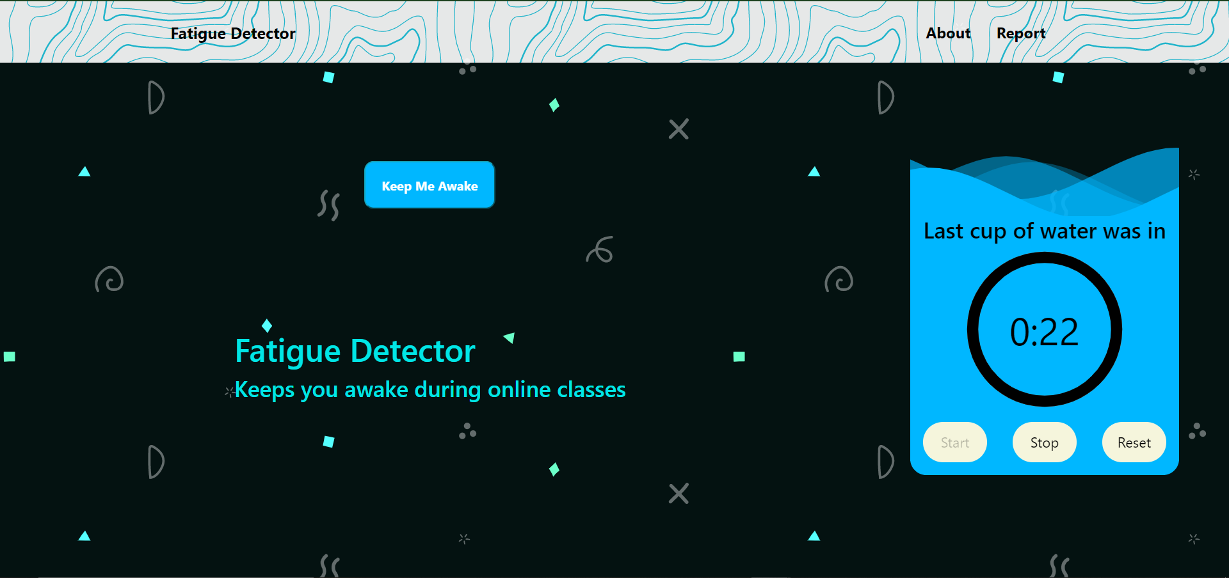

Slide 14
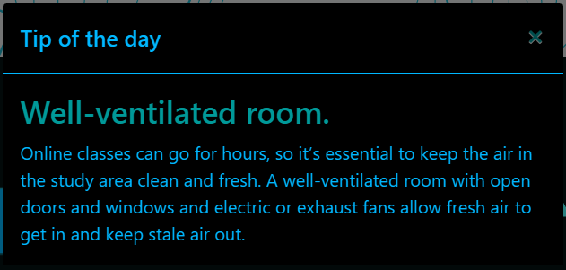
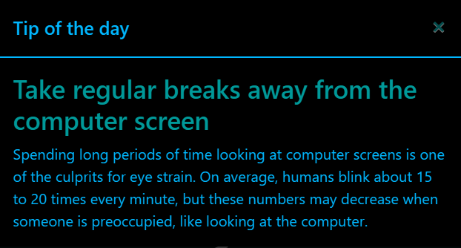
We provide tips every time you visit us

Slide 15
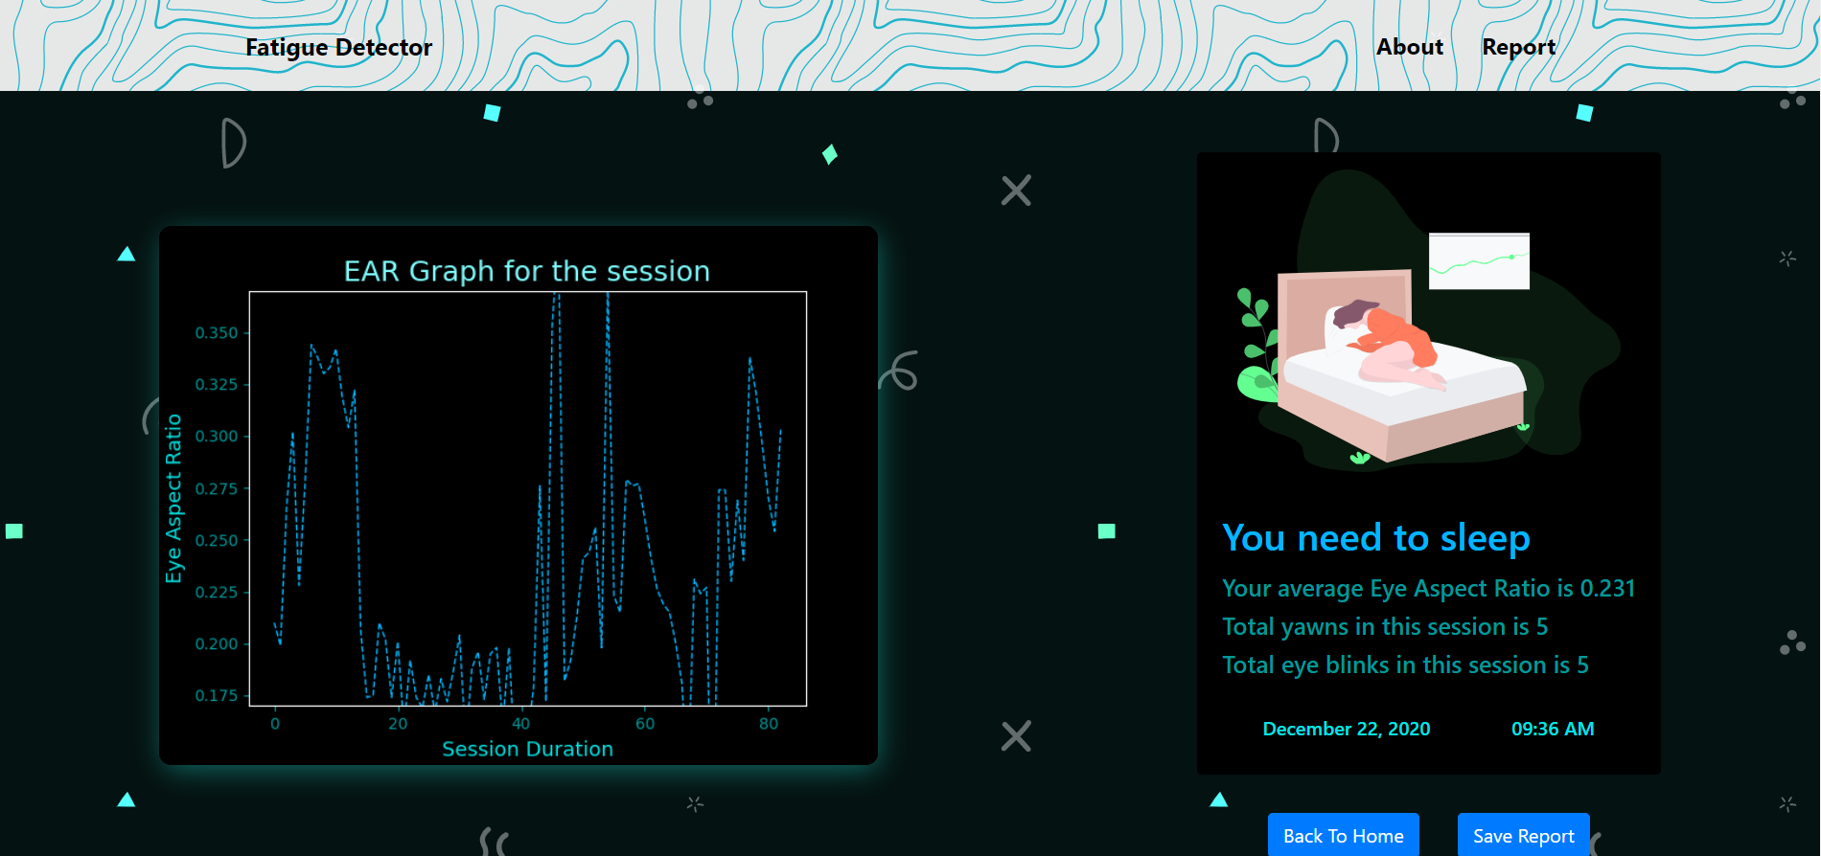

Slide 16
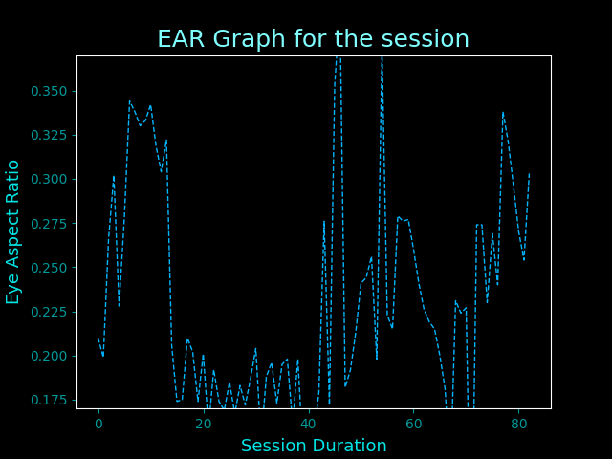
Graph of EYE ASPECT RATIO (EAR)

Slide 17
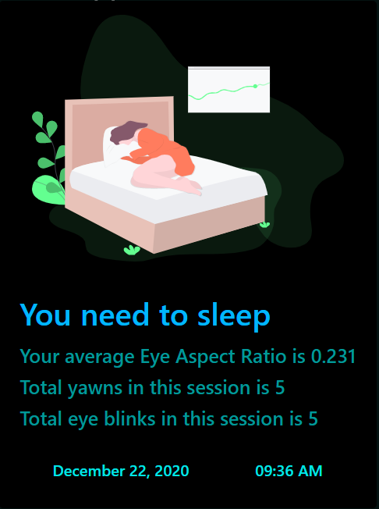
Report Generated at the end of the session

Slide 18
DEMONSTRATION

Slide 19
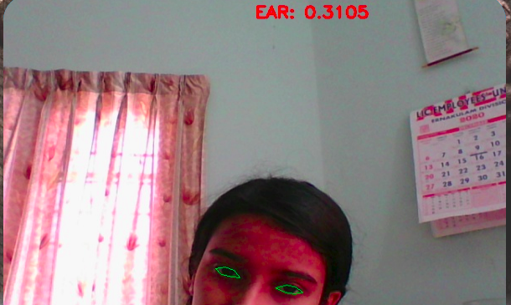
Sleep tiredness being detected

Slide 20
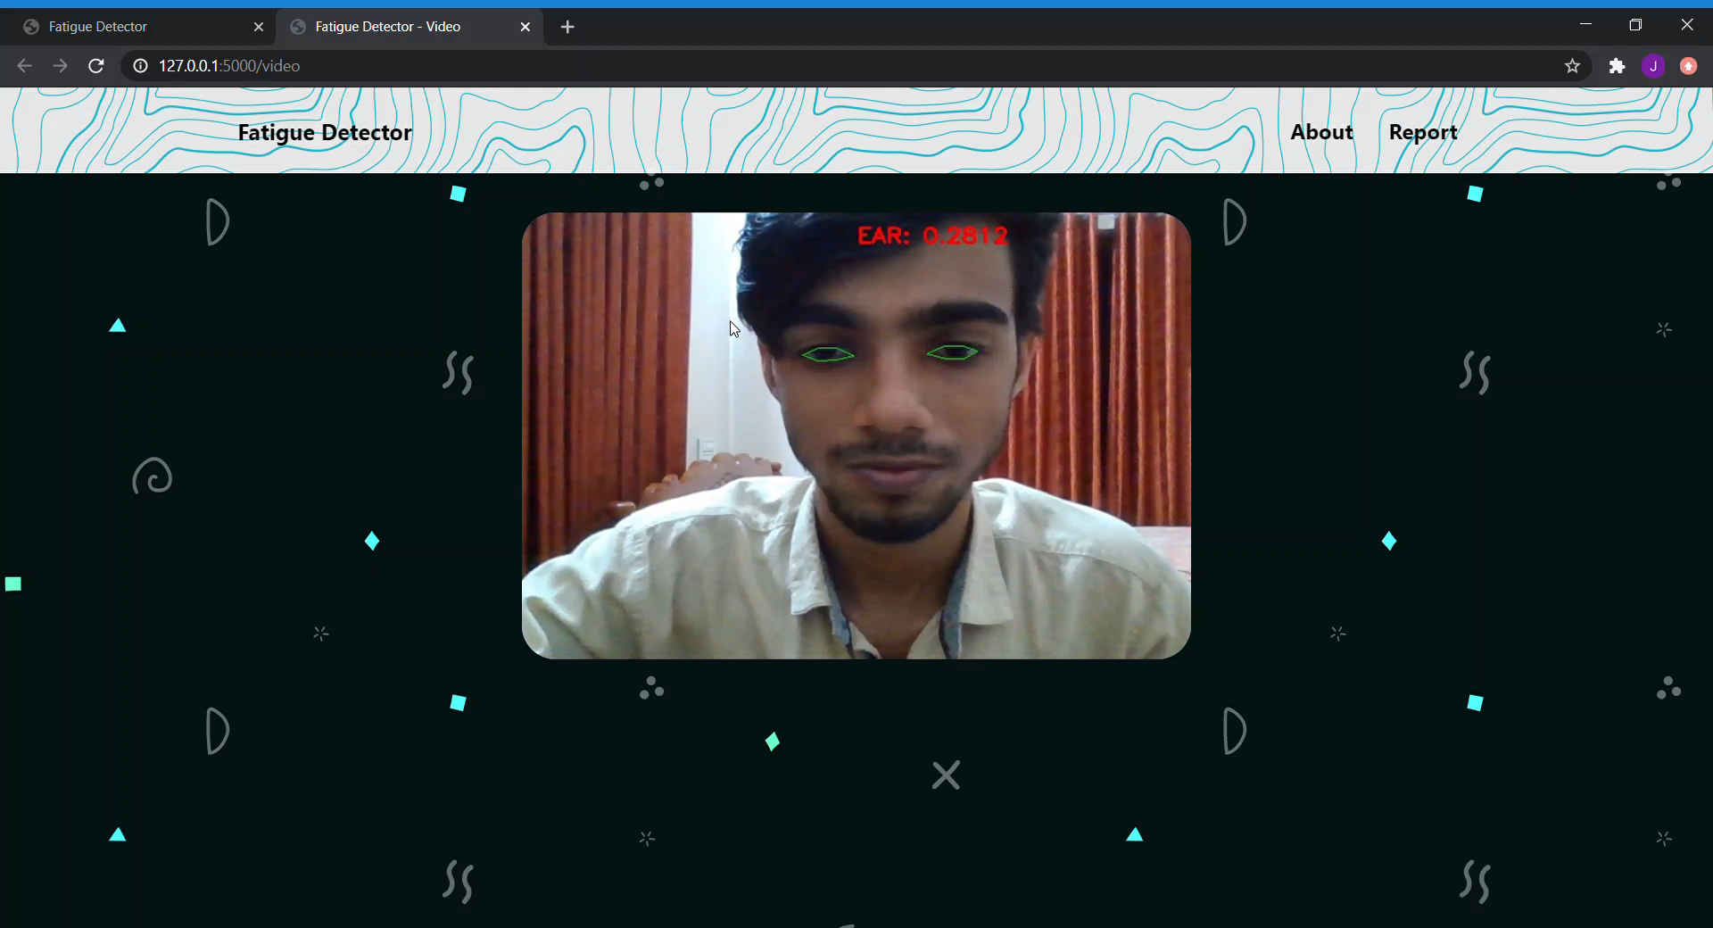
Video Demo

Slide 21
Installation
https://github.com/hhhrrrttt222111/fatigue-detector#installation

Slide 22
Clone The Repo
git clone https://github.com/hhhrrrttt222111/fatigue-detector.git
cd fatigue-detector

Slide 23
Installation for Windows
py -m pip install --upgrade pip
py -m pip install --user virtualenv
py -m venv env
.\env\Scripts\activate
py -m pip install -r requirements.txt

Slide 24
Installation for MacOS & Linux
python3 -m pip install --user --upgrade pip
python3 -m pip install --user virtualenv
python3 -m venv env
source env/bin/activate
pip install -r requirements.txt

Slide 25


